Slide 1
DevOps
Notes:
First coined in 2009 in Belgium, DevOpsDays

Slide 2
What and Why?
"A set of practices intended to reduce the time between committing a change to a system and the change being placed into normal production, while ensuring high quality".
- DevOps, A Software Architect's Perspective
Notes:
Go further
-
If you start at a commit, lead time less of a metric. Also too late to work together.

Slide 3
People are squishy
Also, you’re not the centre of the universe
Notes:
Medicine
-
Devs are chaos

Slide 4

What it’s not
Notes:
It's not Dev now having to do Ops too.
-
It's not Ops no longer having a job
-
It's not outsourcing all your sysadmin work
-
It's not just tooling

Slide 5
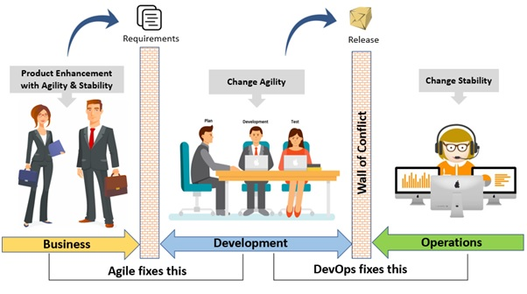
The crux

Slide 6

Way back when

Slide 7
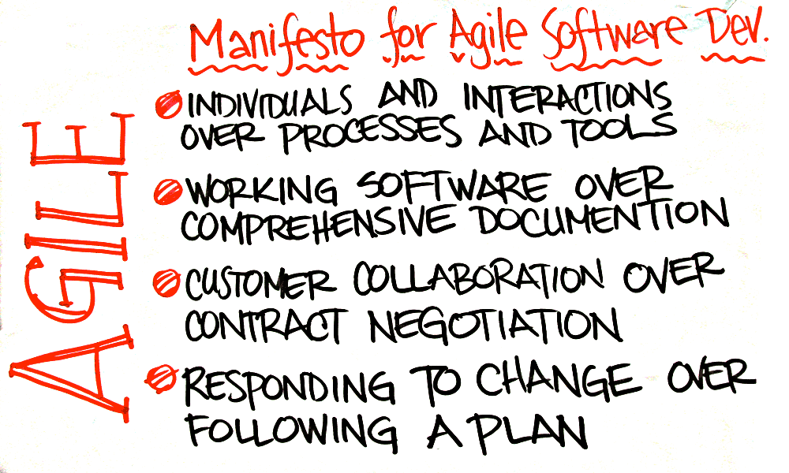
Weren’t you already doing Agile?
Notes:
Agile isn’t binary
-
Think back to summer placements
-
Hands up who spoke to their customers?
-
Hands up who knew they had an Ops team?
-
What was your lead time?
-
Did you ever pivot?

Slide 8
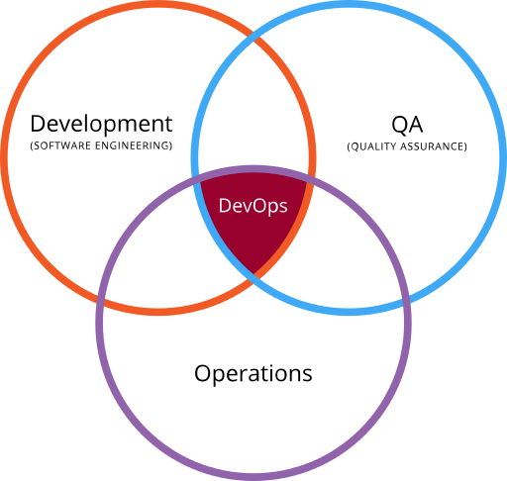
Who’s involved?
What makes a team?
Cyber Security
Dev
Ops
Change Management
Infrastructure
DBAs
SREs
Notes:
Cross functional teams
-
Explain each role

Slide 9
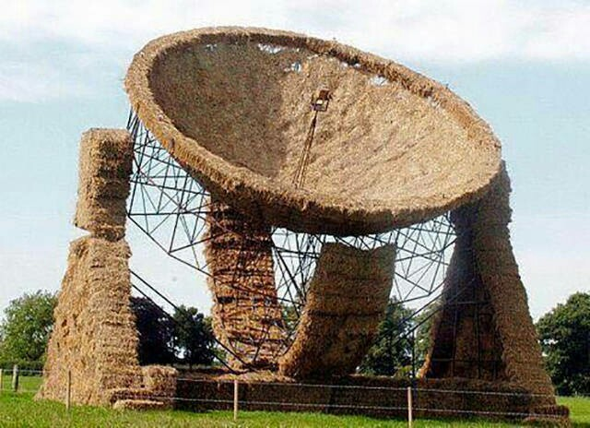
Beware Cargo Cult
Ceremonies == Agile
Notes:
Most famous: World War II
-
Islands in the Pacific Ocean

Slide 10
Agile++

Slide 11
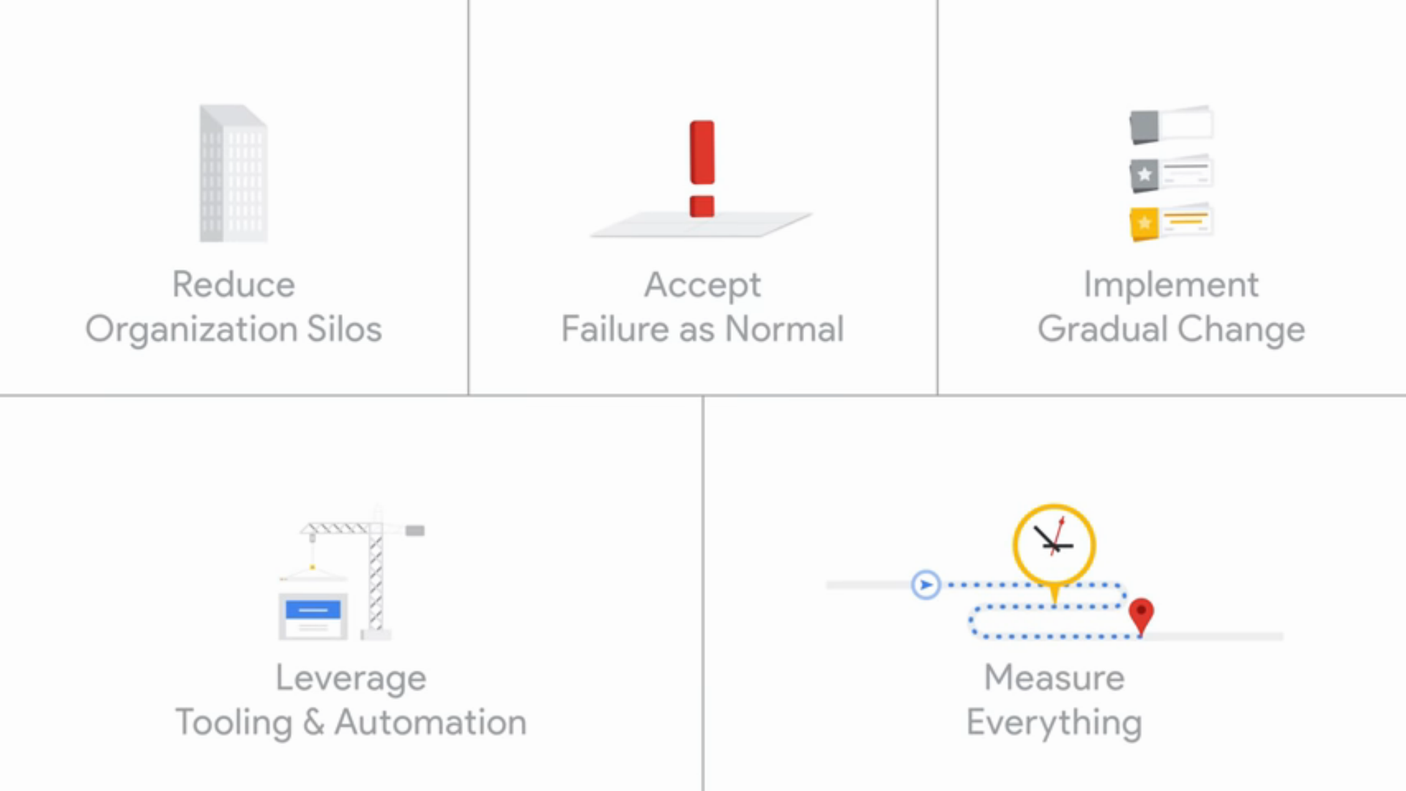
Five tenents of DevOps

Slide 12
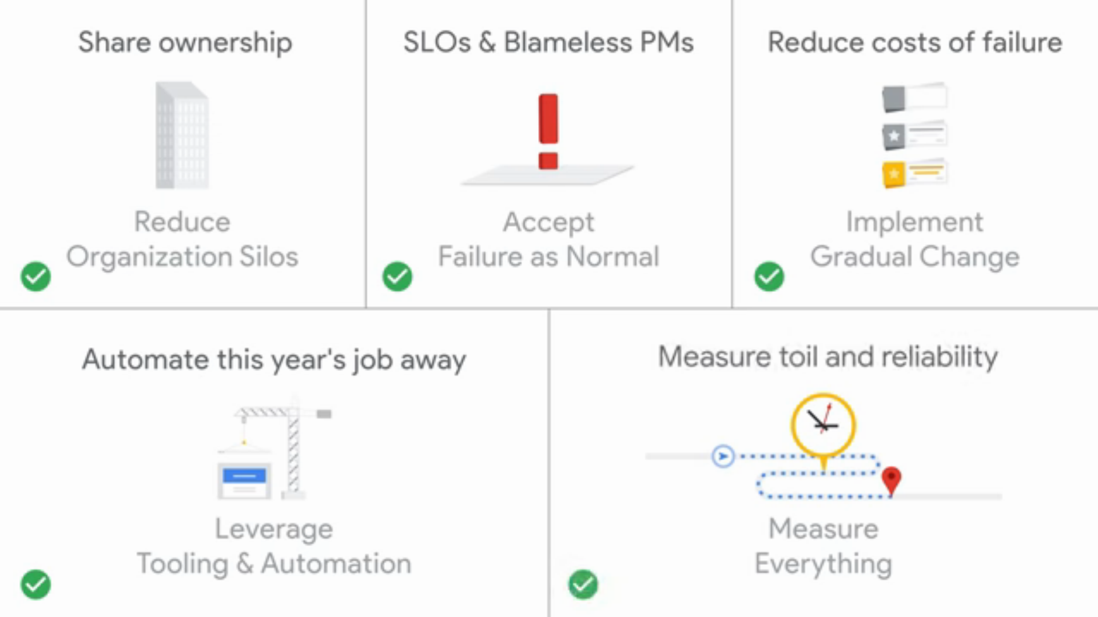
Class SRE implements DevOps
Notes:
To the chagrin of my colleagues, I’m going to suggest Site Reliability Engineering is one way to apply DevOps practices.
-
Google, 2003

Slide 13
Automation tooling/ processes
Remember tooling != Agile or DevOps
Process | Tooling | Benefit
Version Control | Git, Mercurial... | Keep track of software. Keep everyone on same page.
Continuous Integration/ Deployment | Jenkins, Team City | Avoid Merge Hell
Quality Assurance | Sonar, Fitnesse, Spock, JUnit | Reduce risk of changes impacting other parts of a system
Static Analysis | HP Fortify | Security scanning
Circuit Breaking | Hystrix | Condition driven auto-failover/ scaling
Auto-config | Puppet, Chef, Ansible | Infrastructure as Code. Idempotent environments on demand.

Slide 14
The difficulty of Uptime
Availability % | Yearly downtime | Monthly downtime
90% ("one nine") | 36.53 days | 73.05 hours
99% ("two nines") | 3.65 days | 7.31 hours
99.9% ("three nines") | 8.77 hours | 43.83 minutes
99.99% ("four nines") | 52.60 minutes | 4.38 minutes
99.999% ("five nines") | 5.26 minutes | 26.30 seconds
99.9999% ("six nines") | 31.56 seconds | 2.63 seconds

Slide 15
Ok, so how?

Slide 16
Break down silos
Cross-functional teams
Shared backlog
Shared tooling

Slide 17
Working with failure
Service Level Objectives
Blameless Post Mortems
Circuit breakers

Slide 18
Change gradually
Fail cheaply
Release cheaply

Slide 19
SRE: A definition of terms
Acronym | Stands for | Means
SLO | Service Level Objectives | Did we run fast and slow enough over the year?
SLI | Service Level Indicators | What we’re measuring. i.e. Request Latency, Batch Throughput, Failures per request
SLA | Service Level Agreement | What am I going to do if I don't offer the service I promised

Slide 20
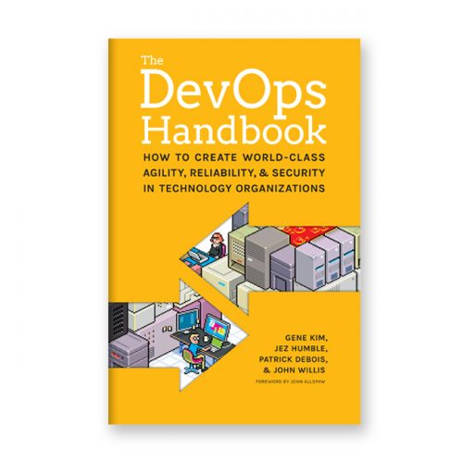
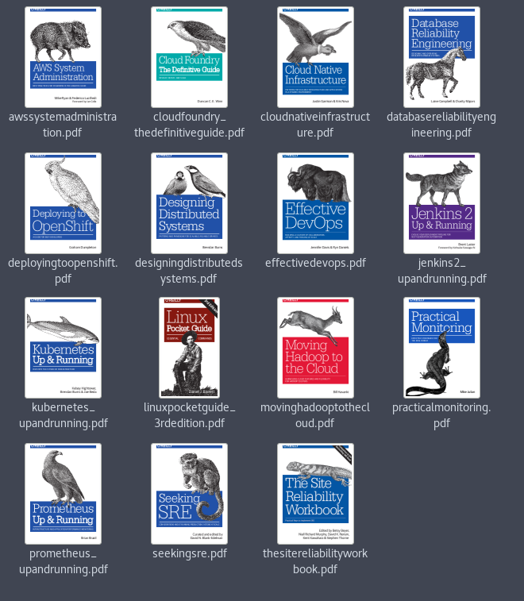
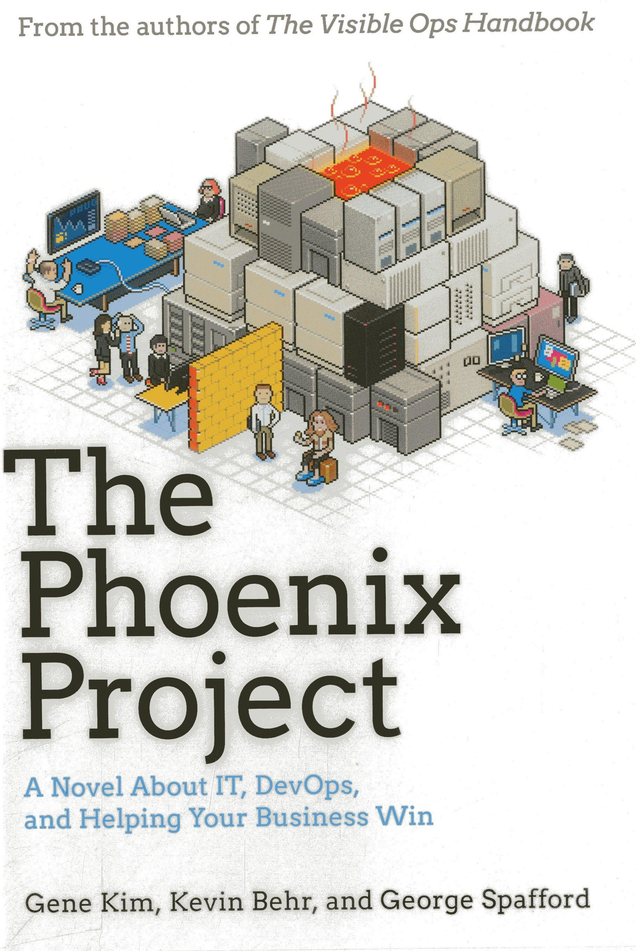
Recommended Reading
Grab the audiobooks, it’s way quicker

Slide 21
Content Header
Subhead
Minctem qui alique nonsequ asinto temquam nullatur aut esto dolorunt as et verspita que pro ipsam sam que vid quiat landem fugit, cum nitem fugit fuga. Itassequam, cones sed que ped ulparum incid molut a incidel luptus ut as eate voles dit, qui il idit, ut vel idebitia se mod entempores ero occaeperum quam id modions equaeprat quam que dolorecatur, volore, aut et eos expla volenie nimillatur, odis volupta ssunt, et, si non pro to molupta turibus doluptat vero blabore peligname simos et odis conescim volorem poriatest, officiur.

Slide 22
Section Header

Slide 23
Section Header
Subhead

Slide 24
Section Header
Subhead

Slide 25
Content Header
Subhead
Minctem qui alique nonsequ asinto temquam nullatur aut esto dolorunt as et verspita que pro ipsam sam que vid quiat landem fugit, cum nitem fugit fuga. Itassequam, cones sed que ped ulparum incid molut a incidel luptus ut as eate voles dit, qui il idit, ut vel idebitia se mod entempores ero occaeperum quam id modions equaeprat quam que dolorecatur, volore, aut et eos expla volenie nimillatur, odis volupta ssunt, et, si non pro to molupta turibus doluptat vero blabore peligname simos et odis conescim volorem poriatest, officiur.

Slide 26

Content Header
Subhead
Minctem qui alique nonsequ asinto temquam nullatur aut esto dolorunt as et verspita que pro ipsam sam que vid quiat landem fugit, cum nitem fugit fuga. Itassequam, cones sed que ped ulparum incid molut a incidel luptus ut as eate voles dit, qui il idit, ut vel idebitia se mod entempores ero occaeperum quam id modions equaeprat quam que dolorecatur, volore,
aut et eos expla volenie nimillatur, odis volupta ssunt, et, si non pro to molupta turibus doluptat vero blabore peligname simos et odis conescim volorem poriatest, officiur.

Slide 27
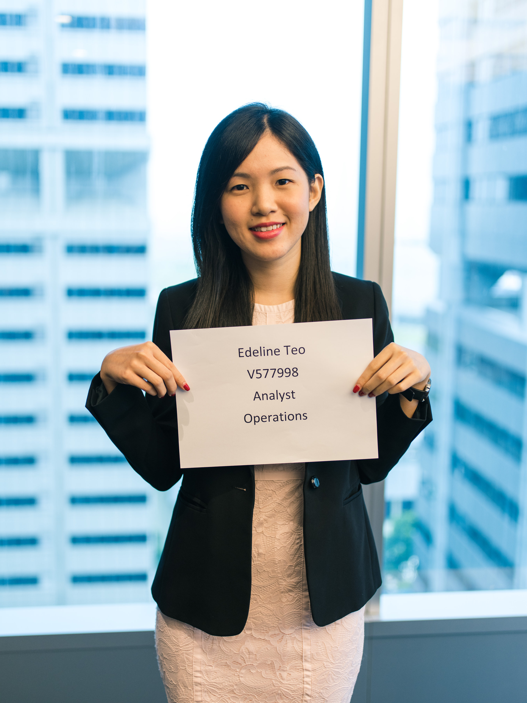
Employee Bio
Subhead
Minctem qui alique nonsequ asinto temquam nullatur aut esto dolorunt as et verspita que pro ipsam sam que vid quiat landem fugit, cum nitem fugit fuga. Itassequam, cones sed que ped ulparum incid molut a incidel luptus ut as eate voles dit, qui il idit, ut vel idebitia se mod entempores ero occaeperum quam id modions equaeprat quam que dolorecatur, volore,
aut et eos expla volenie nimillatur, odis volupta ssunt, et, si non pro to molupta turibus doluptat vero blabore peligname simos et odis conescim volorem poriatest, officiur.

Slide 28

Content Header
Subhead

Slide 29
Content Header
Subhead
Minctem qui alique nonsequ asinto temquam nullatur aut esto dolorunt as et verspita que pro ipsam sam que vid quiat landem fugit, cum nitem fugit fuga. Itassequam, cones sed que ped ulparum incid molut a incidel luptus ut as eate voles dit, qui il idit, ut vel idebitia se mod entempores ero occaeperum quam id modions equaeprat quam que dolorecatur, volore,
aut et eos expla volenie nimillatur, odis volupta ssunt, et, si non pro to molupta turibus doluptat vero blabore peligname simos et odis conescim volorem poriatest, officiur.

